Slide 1

Crop Production Analysis
NAME: AVANI BALMUKUND AMBEKAR
ID: STU65d787724533c1708623730

Slide 2

PROBLEM STATEMENT
The agricultural sector is crucial for the economies of numerous countries, with India being no exception. Precisely forecasting crop production is crucial for effectively organizing agricultural endeavors, allocating resources, and upholding food security. Nonetheless, the prediction of crop production presents difficulties due to factors like weather patterns, soil conditions, and farming techniques.

Slide 3
Project Description
The aim of this project is to create a predictive model capable of anticipating crop production across various states and districts, encompassing different crops and seasons. This model will utilize historical data regarding crop varieties, cultivation areas, and yield quantities. Its purpose is to assist stakeholders in making informed decisions regarding agricultural planning, resource distribution, and market projections, thereby enhancing food security and fostering economic development.

Slide 4

WHO ARE THE END USERS?
The model assists farmers in making data-driven decisions to enhance agricultural productivity.
It aids government agencies in optimizing resource allocation for agricultural development.
Agricultural experts can utilize the model to inform their decisions and strategies for improving crop yields.
By leveraging historical data, the model contributes to ensuring food security by predicting crop production accurately.
It facilitates informed decision-making processes among stakeholders, leading to better planning and management of agricultural activities.

Slide 5

Technology Used
Power BI Desktop
Power Query Editor
Microsoft PowerPoint

Slide 6
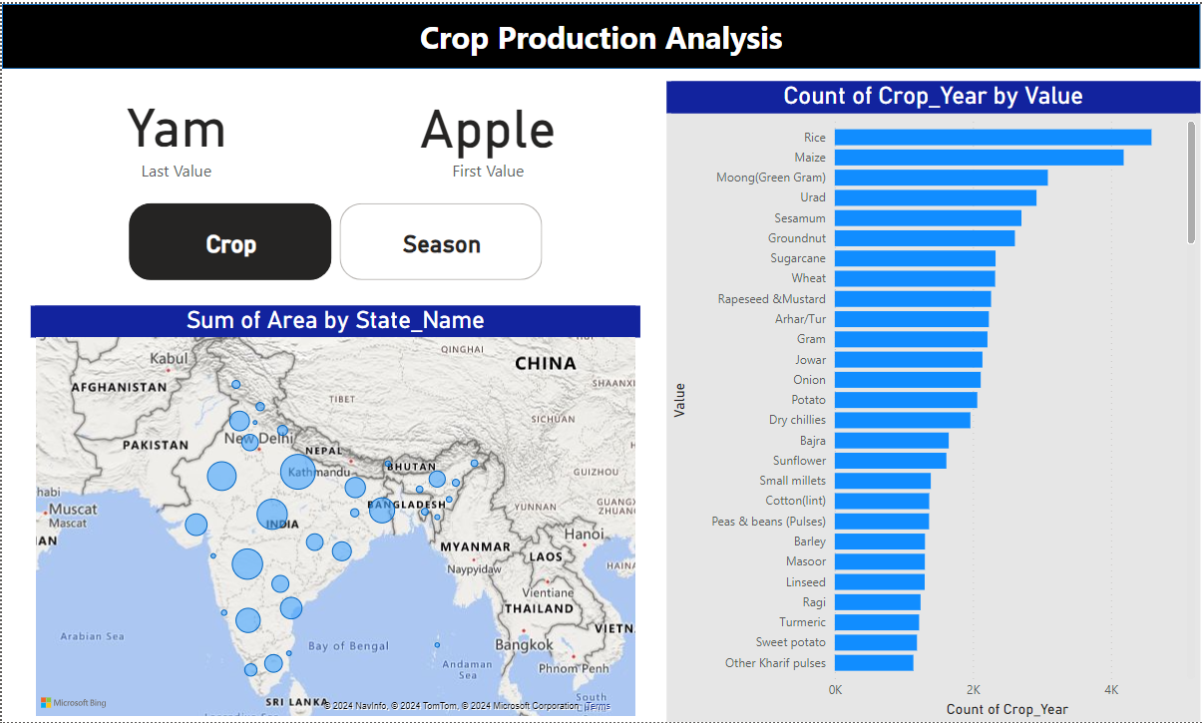
RESULTS

Slide 7
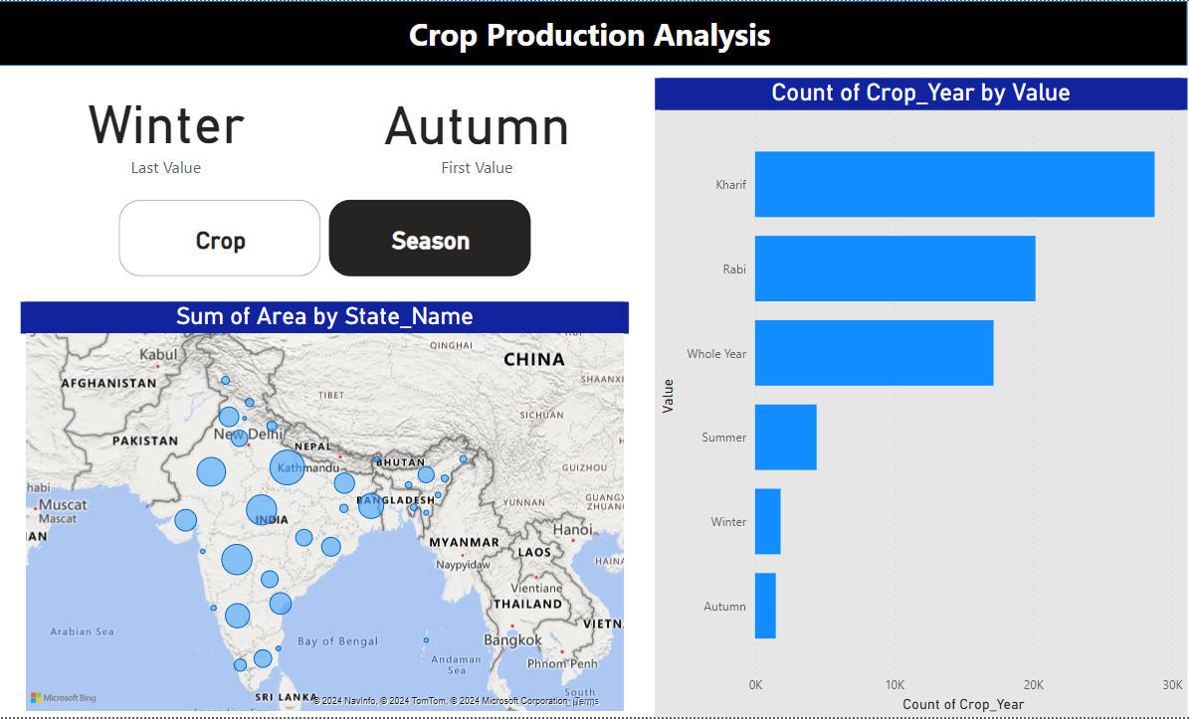
RESULTS

Slide 8
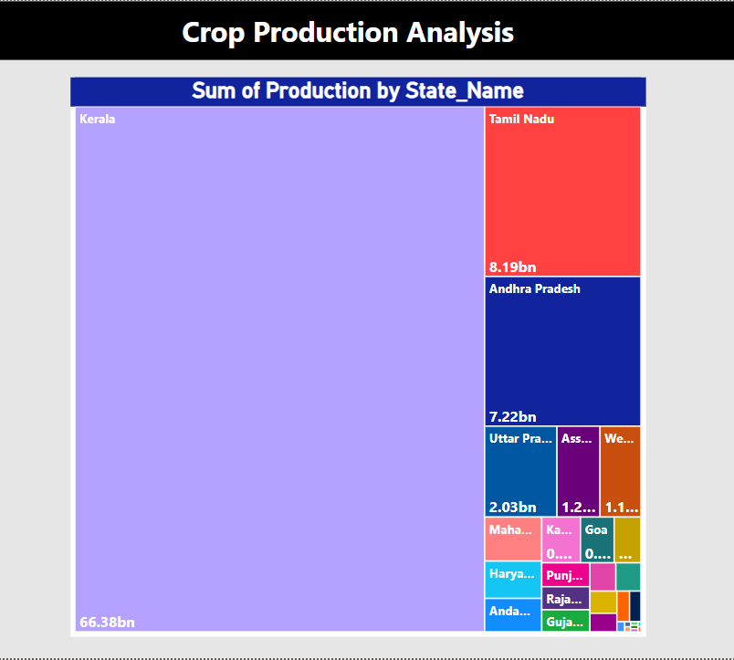
RESULTS

Slide 9
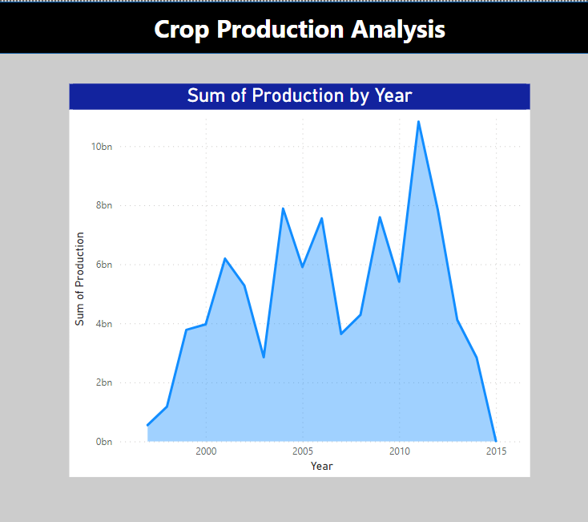
RESULTS

Slide 10
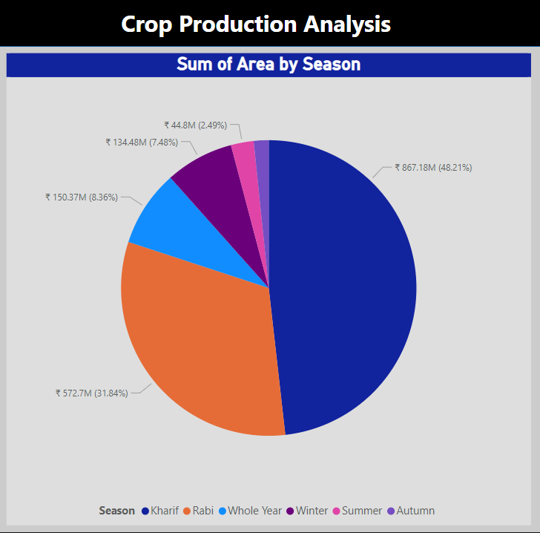
RESULTS

Slide 11
Thank you
.
.

